Slide 1

Synchronization
The Critical Section Problem
Synchronization Hardware
Classic Problems of Synchronization

Slide 2
Priority Inversion
A scheduling challenge
A higher priority process will have to wait for a lower priority process that is currently accessing kernel data
The problem is referred to as priority inversion
May occur in systems with more than two priorities
Solution
Have only two priorities
Insufficient for most general purpose OS
Solution
Use priority-inheritance protocol
All processes that are accessing resources needed by a higher priority process inherit the higher priority until they are finished with the resource

Slide 3
Priority Inversion
Three processes L, M and H where L < M < H
H requires access to R
R is being used by L
M becomes runnable and it preempts L
Problem:
H is affected by M although M is of lower priority
Priority-inheritance protocol
L will inherit the priority of H till it is finished with R
Relinquishes its priority at the release of R
H would use R next

Slide 4
Classic problems of Synchronization
Examples of a large class of concurrency-control problems
Problems used for testing any newly proposed synchronization scheme
The Bounded-Buffer Problem
Commonly used problem to illustrate the power of synchronization primitives
A general structure of the scheme
Assume that the pool consists of n buffers
The mutex semaphore provides mutually exclusive access to the buffer pool
The codes for producer and consumer processes
Symmetry exists between the two

Slide 5
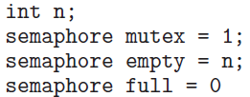
Bounded Buffer Problem –Producer Process
do { . . . . . .
/* produce an item in next_produced */
. . . . . .
wait (empty);
wait (mutex);
. . . . . .
/* add next_produced to the buffer */
. . . . . .
signal (mutex);
signal (full);
} while (true);
Notes:
5

Slide 6
Bounded Buffer Problem – Consumer process
do {
wait (full);
wait (mutex);
. . . . .
/* remove an item from buffer to next_consumed */
. . . . .
signal (mutex);
signal (empty);
. . . . .
/* consume the item in next_consumed */
. . . . .
} while (true);
Notes:
6

Slide 7
Classic problems of Synchronization
The Readers-Writers Problem
Shared data are read and written by various processes
Processes which only read are called readers
Processes which perform both read and write operations are referred to as writers
A writer and another process should not access the data simultaneously
Readers-writers problem
Several variations exist, involving priorities
First readers-writers problem
No reader will be kept waiting unless a writer has already obtained permission to use the shared object

Slide 8
Classic Problems of Synchronization
Second readers-writers problem
Once a writer is ready, it performs its write as soon as possible
If a writer is waiting, no new readers may start reading
Solution to either problem results in starvation
Writers may starve in the first case and readers may starve in the second case
Solution to the first readers-writers problem
Reader processes share some data structures initialized to the indicated values
Code for a writer and a reader process
This problem has been generalized to provide reader-writer locks on some systems

Slide 9

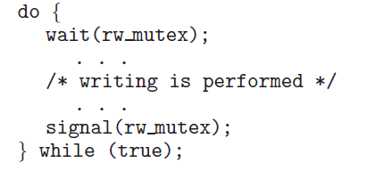
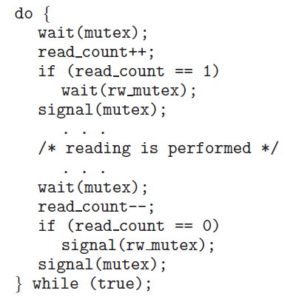
Readers-Writers Problem
Writer process
Reader process
Notes:
9
Rw_mutex is common to both readers and writers; mutex ensures mutually exclusive access to read_count

Slide 10
Classic Problems of Synchronization
Acquiring the lock must specify the mode of the lock
Either read or write access
Multiple processes may access the lock in read mode
Only one process may acquire the lock for writing
Reader-writer locks are useful in the following situations
In applications where it is easy to identify readers and writers
In applications that have more readers than writers

Slide 11
Classic Problems of Synchronization
The Dining-Philosophers Problem
A group of five philosophers share a round table with five chairs, five plates and five chopsticks
A philosopher eats when both chopsticks are available
This represents a large class of concurrency-control problems
Allocate several resources among processes in a deadlock-free and starvation-free manner
Represent each chopstick with a semaphore
semaphore chopstick[5];
No two neighbors are eating simultaneously
The solution could create a deadlock

Slide 12

Dining-Philosophers Problem
Notes:
12

Slide 13
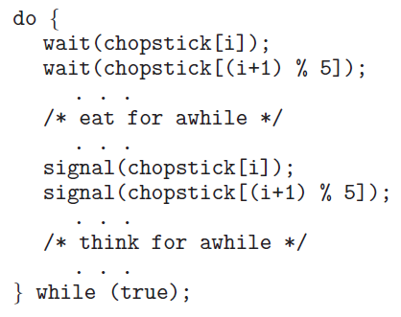
Dining-Philosophers Problem
Structure of Philosopher i
Notes:
13

Slide 14
Classic Problems of Synchronization
Suppose all philosophers pick their right chopstick simultaneously
All would be delayed for ever for their left chopstick
Solutions
Allow at most four philosophers to be sitting at the table simultaneously
Allow philosophers to pick up the chopsticks if both are available
Pick up chopsticks in a critical section
Use an asymmetric solution
An odd numbered philosopher picks up the left chopstick first and then the right chopstick
An even numbered philosopher picks up the right chopstick first and then the left chopstick
Possibility of starvation exists

Slide 15

Deadlocks
Description of Deadlocks
Methods of Preventing or
Avoiding Deadlocks
Detection and Recovery from Deadlocks

Slide 16
Overview
Why do deadlocks occur?
Methods of dealing with deadlocks
Prevent or avoid deadlocks
Detect and recover from deadlocks
Ignore the problem
Four necessary conditions for deadlocks
Deadlock prevention and avoidance algorithms
Safe sequence
Detection algorithms
Recovery methods
Selection of victim process
Rollback and starvation

Slide 17
Introduction
Several processes compete for a finite number of resources in a multiprogramming environment
When a process requests resources and it is not available
It goes into a wait state
This can be an indefinite wait
Deadlock has occurred
Methods used by OS to deal with deadlocks
Deadlocks may become common due to the current trends

Slide 18
System Model
A system consists of a finite number of resources that are distributed among the competing processes
The resources are of different types and may consist of a number of instances of the same type
Memory space Files
CPU cycles I/O devices
If a process requests a resource of a type
Any instances of that type can satisfy the request
A process must request a resource before using it and must release the resource after using it
The total number of resources requested may not exceed the total number of available resources

Slide 19
System Model
Resource utilization is done in the following sequence of steps
Request: If the request cannot be granted immediately
The process must wait until it acquires the resource
Use: The process can operate on the resource
Release: The process releases the resource
Request and release of resources are done through system calls
Request and release of semaphores can be accomplished through wait() and signal() operations on semaphores
OS maintains a table of the current allocations of all the resources

Slide 20
System Model
A set of processes are in a state of deadlock when every process in the set is waiting for an event that can be caused only by another process in the set
Events are acquisition and release of resources
Resources can be both physical and logical
Other types of events may also cause deadlock
Deadlock may involve same resource type or different resource types
Multithreaded programs have a greater chance of a deadlock
Use of mutex operation on locks in a particular sequence may result in deadlock

Slide 21
Deadlock Characterization
Examine the features that characterize deadlocks
Processes never complete execution and resources are occupied
Necessary Conditions
A deadlock may occur if the following four conditions hold simultaneously in a system
Mutual exclusion
At least one resource must be held in a non-sharable mode
Hold and wait
A process must be holding at least one resource and is waiting for another resource that is currently being held by another process

Slide 22
Deadlock Characterization
No preemption
Resources cannot be preempted
Circular wait
A set {P0, P1, …, Pn} of waiting processes must exist such that
P0 is waiting for a resource held by P1
P1 is waiting for a resource held by P2,….., and
Pn is waiting for a resource held by P0
Circular wait condition implies the hold-and-wait condition
The four conditions are not completely independent

Slide 23
Resource Allocation Graph
Deadlocks can be described in terms of a directed graph
System resource-allocation graph
Set of vertices V is partitioned into two different types of nodes
P = {P1, P2, …,Pn} The set consisting of all the active processes in the system - circle
R = {R1, R2,…, Rn} The set of all resource types in the system – rectangle with dots
Set of edges E
Request Edge: A directed edge from a process Pi to a resource Rj
It signifies that process Pi has requested an instance of the resource Rj and is currently waiting for the resource
Denoted by Pi → Rj

Slide 24
Resource-Allocation Graph
Assignment edge: A directed edge from a resource type Rj to a process Pi
It signifies that an instance of resource Rj has been allocated to process Pi
Denoted by Rj → Pi
Request edge is converted to an assignment edge if a resource becomes available and is allocated
Assignment edge is deleted when a process releases a resource
Example resource allocation graph
If the graph contains no cycles, no process in the system is deadlocked
Deadlock may exist, if the graph contains cycles

Slide 25
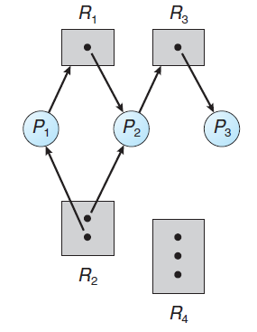
Example of a Resource Allocation Graph
Sets P, R and E
Resource instances
Process states
Notes:
25

Slide 26
Resource Allocation Graph
If each resource type has exactly one instance, a cycle with such resources implies that a deadlock has occurred
A cycle is both a necessary and a sufficient condition
If each resource type has several instances, a cycle does not necessarily imply that a deadlock has occurred
Example resource allocation graphs
If a resource-allocation graph does not have a cycle then the system is not in a deadlocked state

Slide 27
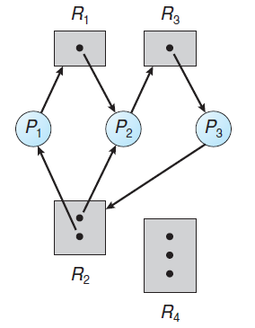
Resource Allocation Graph With A Deadlock
P3 requests an instance of resource R2
Notes:
27

Slide 28
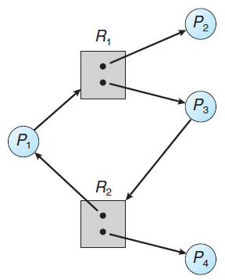
Graph With A Cycle But No Deadlock
Notes:
28

Slide 29
Methods for Handling Deadlocks
Deadlock problem can be handled in one of three ways
Use protocol to prevent or avoid deadlocks
The system never enters a deadlocked state
Allow the system to enter a deadlocked state, detect it and recover
Ignore the problem assuming that deadlocks never occur in the system
None of the basic approaches alone can solve all resource allocation problems
Requires an optimal approach for each class of resources in a system
Deadlock prevention provides a set of methods to ensure that at least one of the necessary conditions cannot hold

Slide 30
Methods for Handling Deadlocks
Deadlock avoidance requires processes to give advance information about their resource needs
Every request is evaluated by OS before allocation to avoid deadlock in future
When the system uses neither prevention nor avoidance algorithms, it may enter into deadlock condition
A deadlock detection algorithm is needed to detect deadlocks if any
In addition, a recovery algorithm is required to recover from deadlock
When none of the above is used in a system, it may enter deadlock and cause a system to stop functioning – manual restart is required
This is the most commonly used method in OS

Slide 31
Deadlock Prevention
Ensure that at least one of the necessary conditions does not hold
Mutual Exclusion
Mutual exclusion is desired for all resources that are not sharable
Deadlock cannot be prevented by denying the mutual-exclusion condition
Some resources are intrinsically nonsharable
Hold and Wait
To deny this condition, following is the requirement
Whenever a process requests a resource, it must be guaranteed that it does not hold any other resources

Slide 32
Deadlock Prevention
Each process acquires all its resources before it begins execution
Place all the system calls for resources in the beginning of the program
Alternative is to allow a process to request a resource only if it has none
A process must release all the resources that it is currently allocated
Process can be restarted only when all the required resources become available
Disadvantages of the above protocols
Resource utilization may be low
Starvation is possible

Slide 33
Deadlock Prevention
No Preemption
To deny this condition, one of the following may be used
If a process is holding some resources and it requests more resources that cannot be immediately granted
All resources that the process is currently holding is preempted
Process is restarted only when all the resources become available
An alternative: If the resource is not available
Check if any of the waiting processes are holding the resource
If this is not true, the requesting process waits
Its resources can be taken away if requested by another process

Slide 34
Deadlock Prevention
This can be applied to resources that can be saved and restored later
Circular Wait
Impose a total ordering of all resource types
Each process requests resources in an increasing order of enumeration
Let {R1, R2, …,Rm} be the set of resource types
Assign each resource type a unique integer
Define a one-to-one function F: R→ N, where N is the set of natural numbers
Protocol to prevent deadlocks
Each process can request resources only in an increasing order of enumeration

Slide 35
Deadlock Avoidance
Deadlock prevention algorithms result in low device utilization and reduced system throughput
Avoid deadlock by requiring additional information about how resources are to be requested
For every request made, system can decide whether or not a process should wait in order to avoid a possible future deadlock
For a request, the system considers
The resources currently available
The resources currently allocated to each process
The future requests and releases of each process

Slide 36
Deadlock Prevention
A process can request instance of resource Rj iff F(Rj) > F(Ri)
An alternative: Whenever a process requires an instance of resource Rj, it has released any resource Ri such that, F(Ri) ≥ F(Rj)
Accomplish this in an application program
Develop an ordering among all synchronization objects in the system
All requests to synchronization objects must be made in increasing order
Application developers must follow the ordering
Function F should be defined according to the normal order of usage of the resources in a system

Slide 37
Deadlock Avoidance
Deadlock prevention algorithms result in low device utilization and reduced system throughput
Avoid deadlock by requiring additional information about how resources are to be requested
For every request made, system can decide whether or not a process should wait in order to avoid a possible future deadlock
For a request, the system considers
The resources currently available
The resources currently allocated to each process
The future requests and releases of each process

Slide 38
Deadlock Avoidance
Simplest model requirement
Each process declare the maximum number of resources of each type that it may need
A deadlock avoidance algorithm dynamically examines the resource-allocation state to ensure that a circular wait state can never exist
Resource allocation state is defined by
The number of allocated and available resources
The maximum demands of the processes
Safe State
A system is in a safe state only if there exists a safe sequence
A sequence of processes <P1, P2, …, Pn> is a safe sequence for the current allocation state

Slide 39
Deadlock Avoidance
If for each Pi, the resource requests that Pi can make can be satisfied by the currently available resources and resources held by all Pj with j<i
If no safe sequence exists, system is unsafe
A safe state is not a deadlocked state
An unsafe state may lead to a deadlock
The behavior of processes controls unsafe state
An example with three processes
Safe and unsafe states
An avoidance algorithm can be developed to allocate resources only if it leaves the system in a safe state
If a process requests a resource that is currently available, it may still have to wait

Slide 40
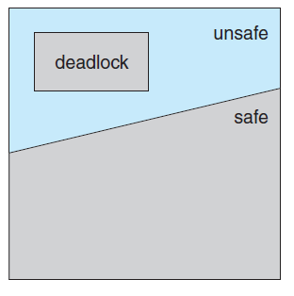
Safe, Unsafe and Deadlocked State
Notes:
40

Slide 41
An Example System
Maximum needs Current needs
P0 10 5
P1 4 2
P2 9 2
System has 12 drives
System is currently safe and the sequence is
<P1, P0, P2>
At time t1, P2 requests a drive and is allocated
The system goes into an unsafe state

Slide 42
Resource-Allocation-Graph Algorithm
If there is only one instance of each resource in a system, a variant of resource-allocation graph can be used for deadlock avoidance
Claim edge is added to this graph in addition to request and assignment edge
A claim edge Pi → Rj indicates that process Pi may request resource Rj at some time in future
Represented in the graph by a dashed line
When the resource is requested, claim edge is converted into request edge
Resources must be claimed a priori
A requested resource is granted to a process only if by converting the request edge to an assignment edge does not result in formation of a cycle in the resource-allocation-graph

Slide 43
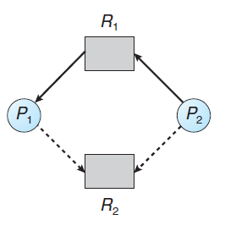
Resource-Allocation Graph
Notes:
43

Slide 44
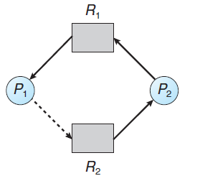
Unsafe State In Resource-Allocation Graph
Notes:
44

Slide 45
Banker’s Algorithm
This algorithms overcomes the limitation of graph-allocation algorithm
Applicable to systems having any number of instances of various resources
A new process entering the system declares it total resource needs
When a request is made, the system ensures that the allocation would not leave the system in an unsafe state
If it does, the process is made to wait until some other process releases its resources
Several data structures need to be maintained to implement the algorithm
Let n be the number of processes in the system and let m be the number of resource types

Slide 46
Banker’s Algorithm
Available
A vector of length m that indicates the number of available resources of each type
Max
An n x m matrix that defines the maximum demand of each process
Allocation
An n x m matrix that defines the maximum number of resources of each type currently allocated to each process
Need
An n x m matrix that indicates the remaining resource need of each process
The data structures vary over time in both size and value

Slide 47
Banker’s Algorithm
Each row in matrices Allocation and Need are treated as vectors referred to as Allocation_{i} and Need_{i}
Some notations
If X and Y are vectors of length n, then
X ≤ Y, iff X[i] ≤ Y[i] for all i = 1,2,…,n
Also, Y < X if Y ≤ X and Y ≠ X
Safety Algorithm
The safety algorithm is described as follows
Let Work and Finish be vectors of length m and n respectively
Initialize Work = Available
Finish [i] = false for i = 0,1,2,…,n-1

Slide 48
Banker’s Algorithm
Find an index i such that both
Finish [i] == false
Need_{i} ≤ Work
If no such i exists, go to Step 4
Work = Work + Allocation
Finish [i] = true
Go to step 2
If Finish [i] == true for all i
The system is in a safe state

Slide 49
Banker’s Algorithm
Resource-Request Algorithm
Determine whether requests can be safely granted
Let Request_{i} be the request vector for process Pi
If Request_{i} [j] == k, then Pi wants k instances of Rj
On a request by Pi
If Request_{i} ≤ Need_{i}, go to step 2
else raise an error condition
If Request_{i} ≤ Available, go to step 3
else Pi must wait as resources are not available

Slide 50
Banker’s Algorithm
Available = Available - Request_{i};
Allocation_{i} = Allocation_{i} + Request_{i};
Need_{i} = Need_{i} - Request_{i};
If the resulting resource-allocation state is safe, transaction is completed
Pi is allocated resources
If the new state is unsafe, Pi must wait
Example Allocation Max Available
A B C A B C A B C
P₀ 0 1 0 7 5 3 3 3 2
P₁ 2 0 0 3 2 2
P₂ 3 0 2 9 0 2 Snapshot at
P₃ 2 1 1 2 2 2 time T₀
P₄ 0 0 2 4 3 3

Slide 51
Example of Banker’s Algorithm
Need
A B C
P₀ 7 4 3
P₁ 1 2 2
P₂ 6 0 0
P₃ 0 1 1
P₄ 4 3 1
The system is in a safe state since the sequence
< P₁, P₃, P₄, P₂, P₀> satisfies safety criteria
Notes:
51

Slide 52
Example: P₁ Request (1,0,2)
Check that Request ≤ Available -
that is, (1,0,2) ≤ (3,3,2)
Allocation Need Available
A B C A B C A B C
P₀ 0 1 0 7 4 3 2 3 0
P₁ 3 0 2 0 2 0
P₂ 3 0 1 6 0 0
P₃ 2 1 1 0 1 1
P₄ 0 0 2 4 3 1
Executing safety algorithm shows that sequence
< P₁, P₃, P₄, P₀, P₂> satisfies safety requirement
Can request for (3,3,0) by P₄ be granted?
Request by P0 of (0,2,0)?
Notes:
52

Slide 53
Deadlock Detection
If prevention and avoidance algorithms are not used, deadlock may occur in a system
An algorithm is required to examine the state of the system to determine deadlock
Algorithm is required to recover from deadlock if it has occurred
Both requirements should be fulfilled for
Systems with single instance of each resource
Systems with several instances of each resource type
Overhead is involved in
Maintaining the information about the current state of the system
Potential losses incurred while recovering from deadlock

Slide 54
Deadlock Detection
Single Instance of Each Resource Type
Use a wait-for graph to detect deadlock
Obtained from the resource allocation graph by removing the resource nodes and collapsing the appropriate edges
Deadlock exists in the system iff the wait-for graph contains a cycle
System needs to maintain the wait-for graph
Invoke an algorithm periodically that searches for a cycle in the graph
Several Instances of a Resource Type
An algorithm to detect deadlocks requires the following time varying data structures

Slide 55
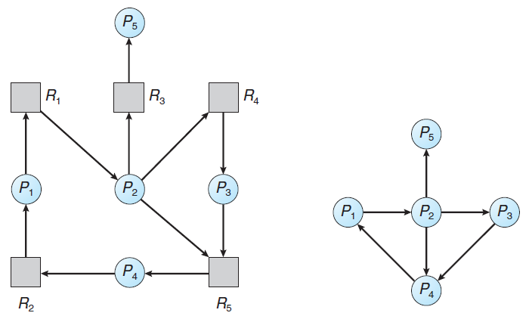
Resource-Allocation Graph and Wait-for Graph
Resource-Allocation Graph
Corresponding wait-for graph
Notes:
55

Slide 56
Deadlock Detection
Available
A vector of length m that indicates the number of instances of each resource type
Allocation
An n x m matrix that defines the number of resources of each type currently allocated to each process
Request
An n x m matrix that indicates the current request of each process
The detection algorithm investigates every possible allocation sequence for the processes that remain to be completed
1. Let Work and Finish be vectors of length m and n respectively
Initialize Work = Available

Slide 57
Deadlock Detection
For i= 0, 1, …, n-1,
if Allocation_{i} ≠ 0, then
Finish[i] = false
else Finish[i] = true
Find an index i such that both
Finish[i] == false
Request_{i} ≤ Work
If no such i exists, go to step 4
Work = Work + Allocation
Finish[i] = true
Go to step 2
If Finish[i] == false, for some i, 0 ≤ i < n then the system is in a deadlocked state
If Finish[i] == false, Pi is deadlocked
Illustration of the algorithm with an example

Slide 58
Example of Detection Algorithm
Allocation Request Available
A B C A B C A B C
P₀ 0 1 0 0 0 0 0 0 0
P₁ 2 0 0 2 0 2
P₂ 3 0 3 0 0 0
P₃ 2 1 1 1 0 0
P₄ 0 0 2 0 0 2
Sequence <P₀, P₂, P₃, P₁, P₄> will result in Finish[i] = true for all i
System is not deadlocked
Notes:
58

Slide 59
Example of Detection Algorithm
P₂ requests an additional instance of type C
Request
A B C
P₀ 0 0 0
P₁ 2 0 1
P₂ 0 0 1
P₃ 1 0 0
P₄ 0 0 2
Deadlock exists, consisting of processes P₁, P₂, P₃, and P₄
Notes:
59

Slide 60
Deadlock Detection
Detection Algorithm Usage
Two factors decide when to invoke detection algorithm
How often deadlock is likely to occur?
How many processes will be affected by it when it happens?
If deadlock occurs frequently, algorithm should be invoked frequently
One extreme
Algorithm is invoked every time a request for allocation cannot be granted immediately
Incurs a considerable overhead in computation time
Invoke at less frequent intervals
Invoke when the CPU utilization drops below a certain level

Slide 61
Recovery From Deadlock
Options to be followed when the detection algorithm detects a deadlock
Abort one or more processes to break the circular wait
Preempt some resources from one or more of the deadlocked processes
Process Termination
One of two methods is used
Abort all deadlocked processes
An expensive method
Abort one process at a time until the deadlock cycle is eliminated
This method incurs a considerable overhead
Aborting a process may leave certain resources in an inconsistent state

Slide 62
Recovery From Deadlock
For partial termination, selection of the process is required
This is a policy decision
Terminate those processes that incur minimum cost
Factors that may affect choice of a process
What is the priority of the process?
How long the process has computed?
How many and what types of resources the process has used?
How many more resources the process needs to complete?
How many processes will need to be terminated?
Whether the process is interactive or batch?

Slide 63
Recovery From Deadlock
Resource Preemption
Successively preempt some resources from processes and give these to other processes until the deadlock cycle is broken
Three issues need to be addressed
Selecting a victim
Which resources and which processes are to be preempted?
Minimize cost while preempting processes
Cost factors include
Number of resources a deadlocked process is holding
Amount of time the process has completed its execution

Slide 64
Recovery From Deadlock
Rollback
What should be done with the process which has its resources preempted?
Rollback the process to some safe state and restart from there
Simplest solution is total rollback:
Abort the process
Starvation
How can we guarantee that resources will not always be preempted from the same process?
Cost factor may select the same process every time deadlock is to be broken
A process should be selected to abort only for a finite number of times
Include the number of rollbacks in the cost factor

